Slide 1
Symbiosis

Slide 3
Table 1. Examples of symbiotic relationships between eukaryotes and microbes. “Other inverts” refers to invertebrates other than insects. Some eukaryotes harbor archaea, bacteria and protozoa, called “all” here. Several hosts obtain ammonium (“nitrogen”) from diazotrophic symbionts while others have bioluminescent (“Biolum”) symbionts. “Organic C” is organic carbon while “reduced S” is reduced sulfur compounds like hydrogen sulfide. Based on Douglas (2010) and other sources cited in the main text.
 |  |  |  | Benefit to:
Eukaryote Type | Eukaryote | Symbiont type | Microbe | Host | Symbiont
Microbe | Ciliates | Archaea | Methanogen | Energetics | Hydrogen gas
Microbe | Ciliates | Bacteria | Various | Organic C | Energy
Microbe | Diatom | Bacteria | Richelia | Nitrogen | Protection
Microbe | Flagellates | Bacteria | Various | Organic C | Organic C
Microbe | Paramecium | Bacteria | Caedibacter | Defense | Organic C
Microbe | Fungus | Algae | Various | Organic C | Protection
Plant | Azolla | Bacteria | Anabaena | Nitrogen | Organic C
Plant | Legumes | Bacteria | Rhizobium | Nitrogen | Organic C
Plant | Alder | Bacteria | Frankia | Nitrogen | Organic C
Plant | Various | Fungi | Fungi | Nutrients | Organic C
Insects | Aphids | Bacteria | Buchnera | Organic C | Organic C
Insects | Carpenter ants | Bacteria | Blochmannia | Organic C | Organic C
Insects | Cockroaches | Bacteria | Bacteriodetes | Amino acids | Uric acid
Insects | Mealy bugs | Bacteria | Tremblaya | Organic C | Organic C
Insects | Sharpshooter | Bacteria | Homalodisca | Organic C | Organic C
Insects | Termite | All | Various | Organic C | Organic C
Insects | Tsetse fly | Bacteria | Wigglesworthia | Organic C | Organic C
Other Inverts | Corals | Algae | Symbiodinium | Organic C | Ammonium
Other Inverts | Deep-sea clam | Bacteria | Ruthia, Vesicomyosocius | Organic C | Reduced S and O2
Other Inverts | Leeches | Bacteria | Aeromonas, Rikenella | Organic C | Organic C
Other Inverts | Mussels | Bacteria | Proteobacteria | Organic C | Methane
Other Inverts | Nematode | Bacteria | Xenorhabdus | Organic C | Organic C
Other Inverts | Oligochaetes | Bacteria | Various bacteria | Organic C | Reduced S
Other Inverts | Shipworm | Bacteria | Teredinibacter | Organic C | Organic C
Other Inverts | Various | Bacteria | Vibrios | Biolumin. | Organic C
Vertebrates | Fish | Bacteria | Vibrios | Biolumin. | Organic C
Vertebrates | Ruminants | All | Various | Organic C | Organic C

Slide 4
Table 1. Examples of symbiotic relationships between eukaryotes and microbes. “Other inverts” refers to invertebrates other than insects. Some eukaryotes harbor archaea, bacteria and protozoa, called “all” here. Several hosts obtain ammonium (“nitrogen”) from diazotrophic symbionts while others have bioluminescent (“Biolum”) symbionts. “Organic C” is organic carbon while “reduced S” is reduced sulfur compounds like hydrogen sulfide. Based on Douglas (2010) and other sources cited in the main text.
 |  |  |  | Benefit to:
Eukaryote Type | Eukaryote | Symbiont type | Microbe | Host | Symbiont
Microbe | Ciliates | Archaea | Methanogen | Energetics | Hydrogen gas
Microbe | Ciliates | Bacteria | Various | Organic C | Energy
Microbe | Diatom | Bacteria | Richelia | Nitrogen | Protection
Microbe | Flagellates | Bacteria | Various | Organic C | Organic C
Microbe | Paramecium | Bacteria | Caedibacter | Defense | Organic C
Microbe | Fungus | Algae | Various | Organic C | Protection
Plant | Azolla | Bacteria | Anabaena | Nitrogen | Organic C
Plant | Legumes | Bacteria | Rhizobium | Nitrogen | Organic C
Plant | Alder | Bacteria | Frankia | Nitrogen | Organic C
Plant | Various | Fungi | Fungi | Nutrients | Organic C
Insects | Aphids | Bacteria | Buchnera | Organic C | Organic C
Insects | Carpenter ants | Bacteria | Blochmannia | Organic C | Organic C
Insects | Cockroaches | Bacteria | Bacteriodetes | Amino acids | Uric acid
Insects | Mealy bugs | Bacteria | Tremblaya | Organic C | Organic C
Insects | Sharpshooter | Bacteria | Homalodisca | Organic C | Organic C
Insects | Termite | All | Various | Organic C | Organic C
Insects | Tsetse fly | Bacteria | Wigglesworthia | Organic C | Organic C
Other Inverts | Corals | Algae | Symbiodinium | Organic C | Ammonium
Other Inverts | Deep-sea clam | Bacteria | Ruthia, Vesicomyosocius | Organic C | Reduced S and O2
Other Inverts | Leeches | Bacteria | Aeromonas, Rikenella | Organic C | Organic C
Other Inverts | Mussels | Bacteria | Proteobacteria | Organic C | Methane
Other Inverts | Nematode | Bacteria | Xenorhabdus | Organic C | Organic C
Other Inverts | Oligochaetes | Bacteria | Various bacteria | Organic C | Reduced S
Other Inverts | Shipworm | Bacteria | Teredinibacter | Organic C | Organic C
Other Inverts | Various | Bacteria | Vibrios | Biolumin. | Organic C
Vertebrates | Fish | Bacteria | Vibrios | Biolumin. | Organic C
Vertebrates | Ruminants | All | Various | Organic C | Organic C

Slide 5
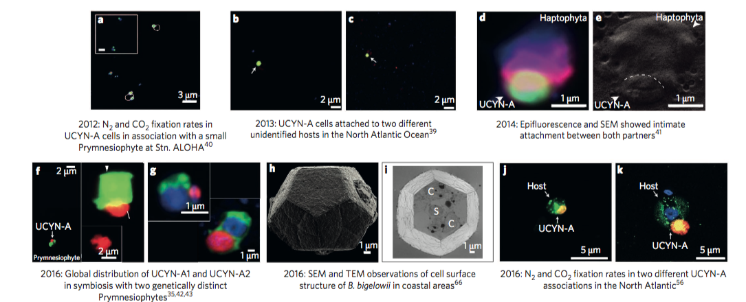
Symbiosis for N₂

Slide 6
Table 4. N₂ fixation rates by symbiotic and nonsymbiotic prokaryotes in terrestrial systems. “NA” is not applicable. Data from (Cleveland et al. 1999) and (Evans and Barber 1977).
 |  | N₂ fixation (mmol N m⁻² d⁻¹)
Environment |  | Symbiotic | Nonsymbiotic | Symbiont
 | Tundra | 0.112 | 0.035 | Rhizobia
 | Boreal forest | 0.023 | 0.024 | Frankia
 | Temperate forest | 2.249 | 0.133 | Rhizobia and Frankia
 | Grasslands | 0.062 | 0.215 | Rhizobia
 | Savannah | 0.756 | 0.251 | Rhizobia
 | Arid shrub land | 1.275 | <0.01 | Rhizobia
 | Tropical forests | 0.365 | 0.202 | Rhizobia
Plant
 | Soybeans | 148 | NA | Rhizobia
 | Clover | 258 | NA | Rhizobia
 | Azolla | 613 | NA | Anabaena
 | Alnus (alder) | 333 | NA | Frankia
 | Ceanothus | 117 | NA | Frankia
 | Coriaria | 294 | NA | Frankia

Slide 7
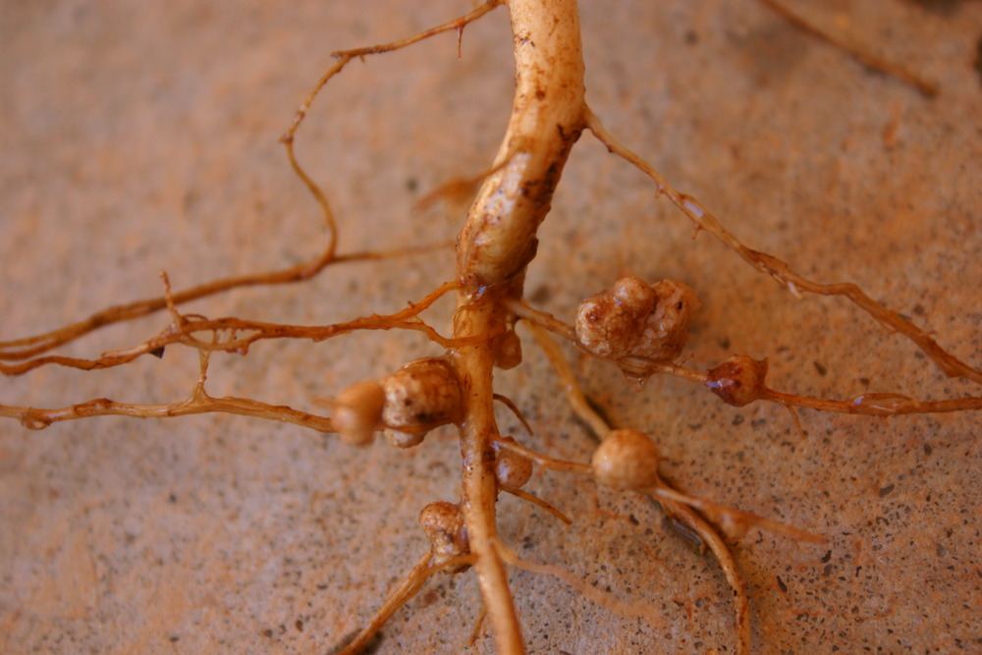
By Stdout - http://allthingsplants.com/plants/photo/73597/. This photo was taken by Dave Whitinger at All Things Plants. Released under the GFDL, as documented here., CC BY-SA 3.0, https://commons.wikimedia.org/w/index.php?curid=19212279

Slide 8
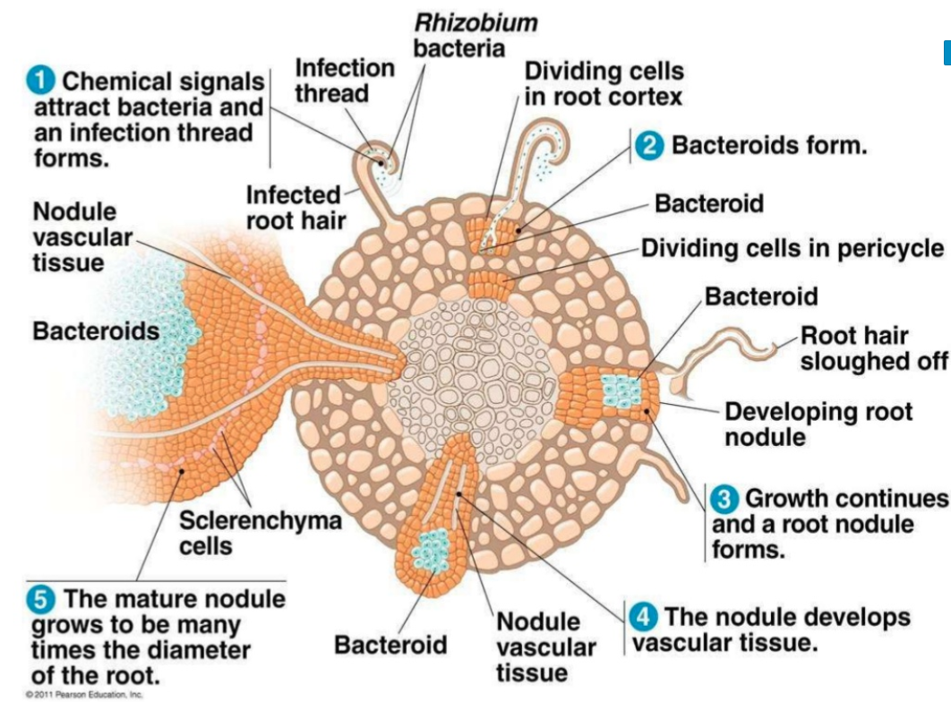

Slide 10
Symbiosis for defense
Bobtail squid
Born without bacteria
Vibrio fischeri
Acquired by squid from environment

Slide 11
Quorum sensing in Vibrio fischeri
LuxI produces signal:
acylated homoserine lactone (AHL) autoinducers
LuxR “sees” signal
When enough AHL is around, LuxR is active as a transcription factor, activates luciferase

Slide 12
Regulated by Quorum Sensing:

Slide 13
Bobtail squid
https://www.youtube.com/watch?v=3ivMSCi-Y2Q

Slide 14
Symbiosis with vertebrates
Digestion-based
Increase ability to digest poor/difficult quality foods
Rumen
Bacteria give: digestion of cellulose, high quality protein, volatile fatty acids, B vitamins, detoxification
Ruminant gives: housing, waste removal, nutrients, optimal environment for growth

Slide 16
Table 2 Sources of methane in the biosphere. Some of the methane labeled as being from free-living methanogens is probably from gut-dwelling microbes or other symbiotic methanogens. Data from (Conrad 2009) .
Process | Source | % of Total
Symbiotic Microbes | Ruminants | 17
 | Termites | 3
Subtotal |  | 20
Free-living Microbes | Wetlands | 23
 | Rice fields | 10
 | Landfills | 7
 | Plants | 6
 | Sewage treatment | 4
 | Gas hydrates | 3
 | Oceans | 3
Subtotal |  | 56
Not by microbes | Fossil fuels | 18
 | Biomass burning | 7
Subtotal |  | 25
 | Total | 100

Slide 17
Human systems
Gut microbes key for health: mutualism
Microbes stimulate, regulate and possibly assist in developing the immune system
Gut microbes can do anything!
Depression, nervous system, digestion
Dysbiosis leads to disease

Slide 18
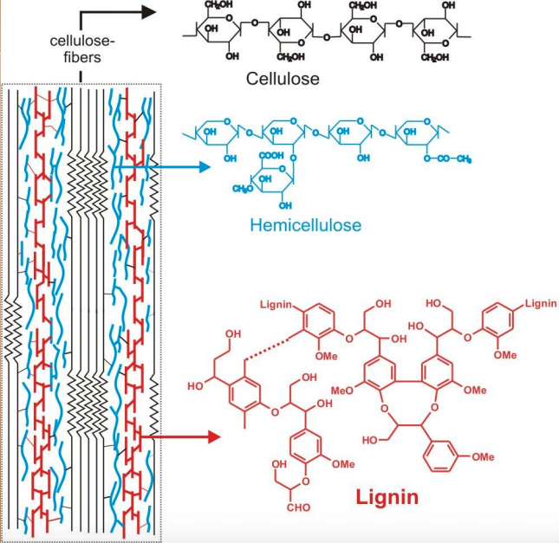
What degrades wood?

Slide 19
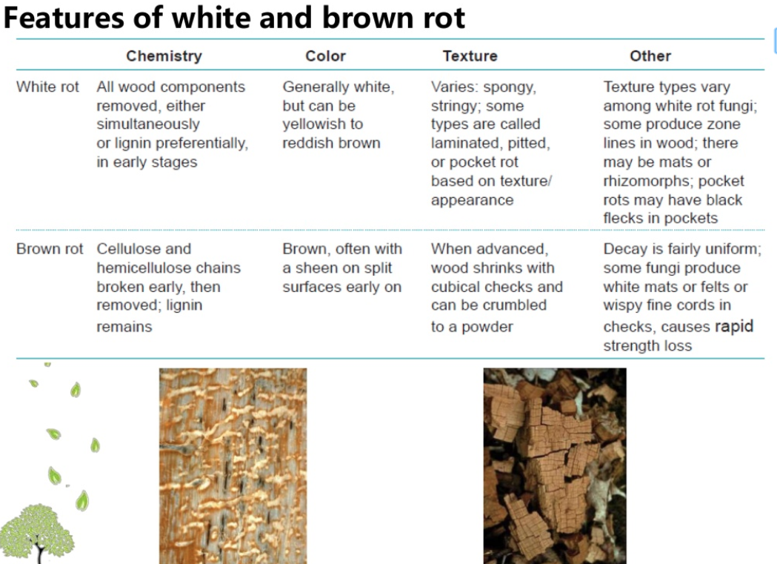
White rot and brown rot fungi

Slide 21
Termites: Anaerobic Hindgut
Protozoa, bacteria and archaea provide acetate to termite

Slide 22
Symbioses with insects
Wolbachia

Slide 23
Transmission of symbionts
Wolbachia
https://www.youtube.com/watch?time_continue=185&v=ut2UxF5gEDI

Slide 24
Leaf-cutter ants

Slide 25
Leaf cutter ants
https://www.youtube.com/watch?v=Xxnmh4IDYaU

Slide 26
Chemosynthetic symbionts
Direct acquisition of primary productivity without sunlight
Hydrothermal systems
Deep sea

Slide 27
Table 3. Examples of marine invertebrates with symbiotic bacteria. “Vents” refers to hydrothermal vents, and “seeps” are cracks in the ocean floor where methane and other gases leak out. Based on (Stewart et al. 2005) and other references cited in the text.
 | Common | Location in | Symbiont
Invertebrate | name | Host | Metabolism | Habitat
Alvinellidae | worms | surface | chemoautotroph | vents
Ascidians | sea squirts | cloaca | photoautotrophy | benthos
Bivalvia | shipworms | gills | heterotrophy | wood detritus
Cephalopods | squids | light organ | heterotrophy | water column
Clitellata | oligochaetes | subcuticular | chemoautotrophy | coral sands
Crustacea | shrimp | exoskeleton | chemoautotrophy | vents
Echinodermata | sea urchins | extracellular | chemoautotrophy | anoxic sediments
Mytilidae | mussels | gills | methanotrophy | cold seeps
Polychaete | tubeworm | trophosome | chemoautotrophy | vents
Nemata | nematodes | cuticle | chemoautotrophy | anoxic sediments
Provannidae | snails | gills | chemoautotrophy | vents
Several | detritivores | gut | heterotrophy | sediments
Solemyidae | clams | gills | chemoautotrophy | anoxic sediments

Slide 29
Symbiosis
Commensalism, parasitism, mutualism
Be able to explain the systems:
Root nodules, bobtail squid in particular

Slide 30
THIS IS THE LAST LECTURE
Paper discussion Wednesday
Exam May 11, due May 15
No lecture on May 11 – do the exam!
Lecture May 13 not on the exam, will showcase Wikipedia updates that day.
Class on May 18 canceled.

